Slide 1

Game Design Goal Oriented Approach for Procedural Content Generation
National Taiwan University of Science and Technology
Department of Computer Science and Information Engineering
Ze-Hao Wang
Master Thesis Oral Defense
July 27, 2017
Prof. Wen-Kai Tai
Committee Chairperson
Prof. Hsing-Kuo Pao
Committee Member
Prof. Tung-Ju Hsieh
Committee Member
Prof. Wen-Huang Cheng
Committee Member

Slide 2
Agenda
Introduction
Related Works
Mission / Space framework
Map Sketches & Evolution of Segments
Proposed Methodologies
System Framework
Mission Grammars
Room Definitions and Instruction
Genetic Algorithm in Segments Evolution
Experimental Results
Conclusions and Contributions
Future work

Slide 3
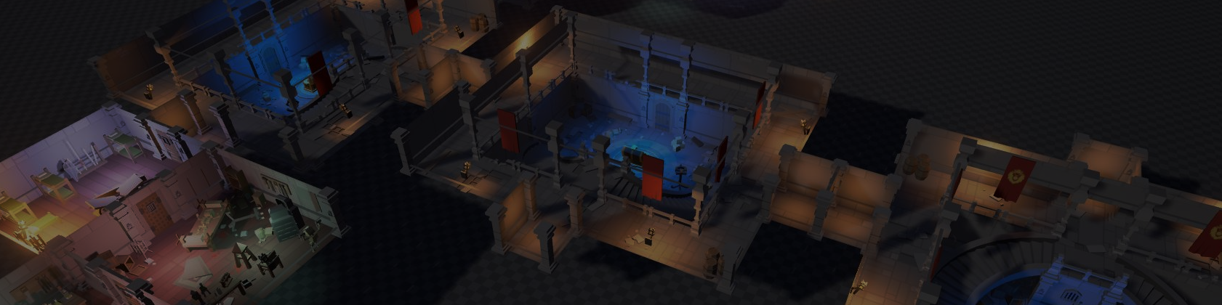
Introduction
Motivation
Research Goals

Slide 4

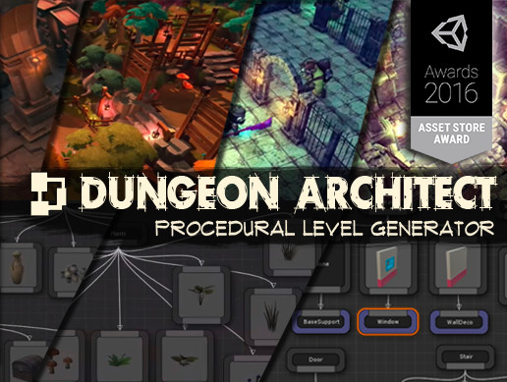
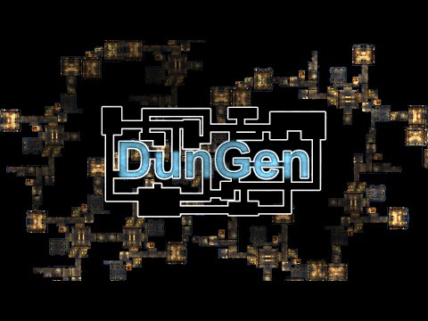
Motivation
[會再翻成英文]
程序化內容自動生成 (Procedural Content Generation) 在過去就廣泛被應用於遊戲設計領域，其主要目的為增加遊戲內容的隨機性與多樣性。我們預期讓玩家在進行遊戲時能夠遵循關卡設計師的劇情脈絡外，亦能夠體驗到有意義且多樣化的遊戲關卡內容。
複雜系統
 | Dungeon Architect | DunGen
Build topology | Randomly PCG, Manually | Randomly PCG
Mission-based topology | None | Stable-linear structure
Dungeon Architect
DunGen

Slide 5
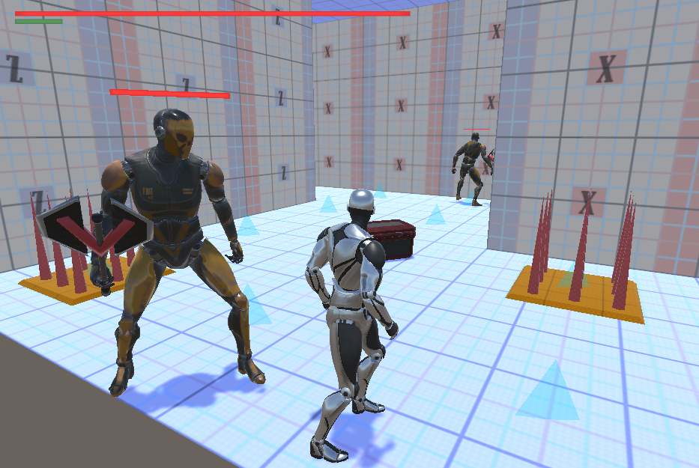
Research Goals
[會再翻成英文]
我們針對遊戲過程中的遊玩特徵 (gameplay patterns) 進行抽象化，使用程序化生成技術產生帶有意義遊戲關卡內容，藉此消彌或降低因隨機性所產生的不穩定要素，以改善並豐富遊戲體驗。
 | Our Method | Dungeon Architect | DunGen
Build topology | PCG | Randomly PCG, Manually | Randomly PCG
Mission-based topology | Dynamic-nonlinear, meaningful structure | None | Stable-linear structure
Game Patterns | Genetic Algorithm | None | None
Our Method

Slide 6
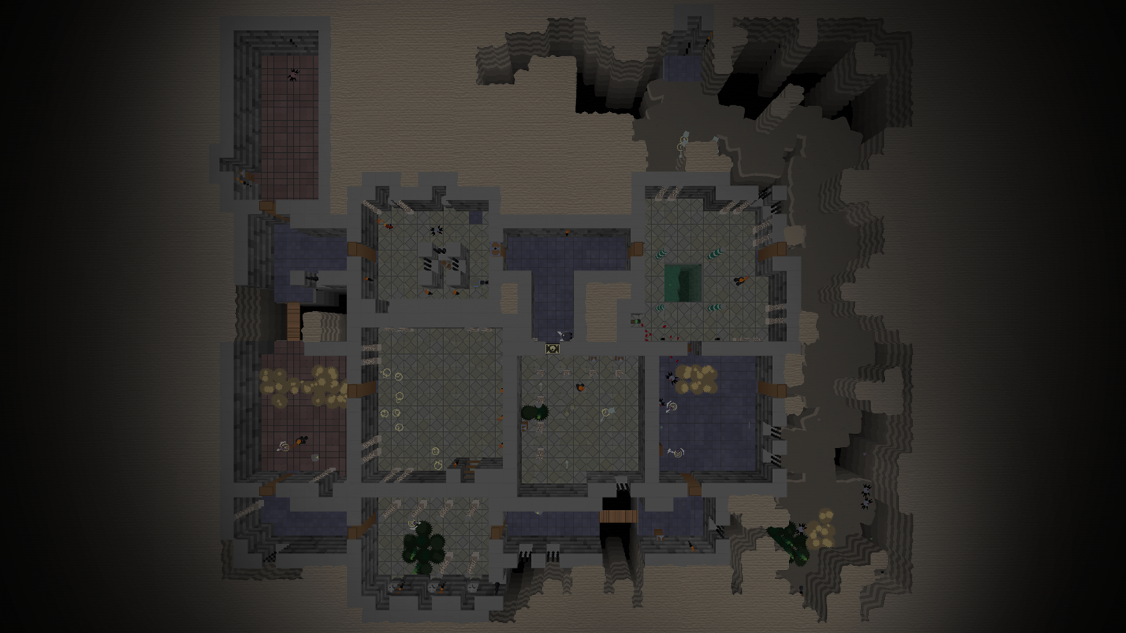
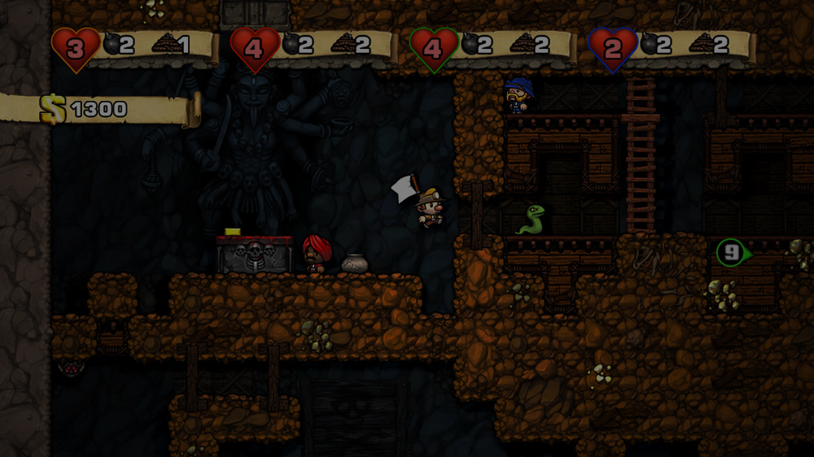
Related Works
Mission / Space framework
Map Sketches & Evolution of Segments

Slide 7
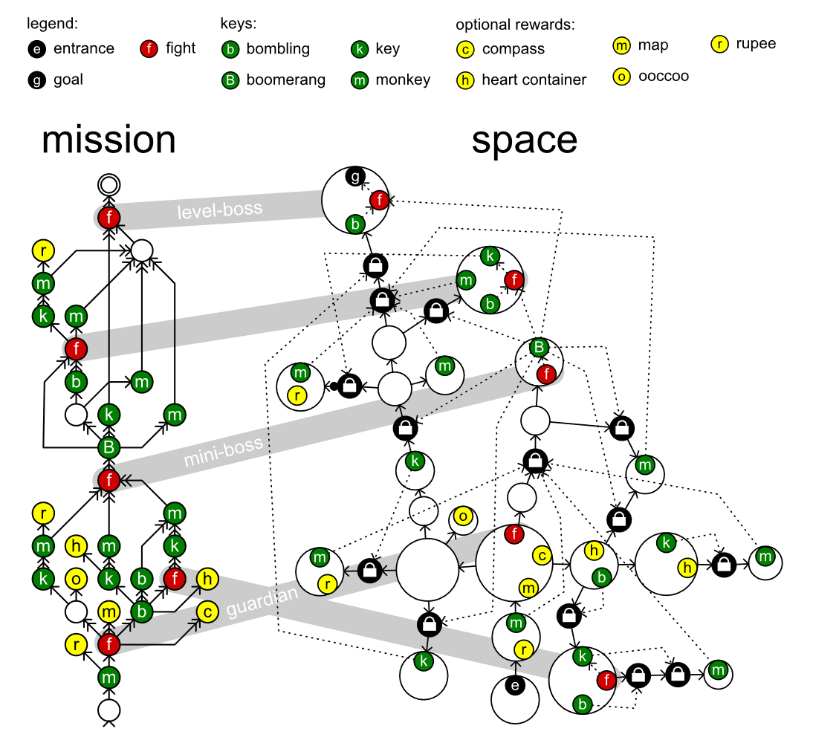
Mission / Space framework
Mission/Space framework, focuses on level design and the mechanics that control player progression through a game.
Transformational Grammars
Mission Grammars
Space Grammars
Mission Graph Convert into Space Graph

Slide 8
Transformational Grammars
Be consisted from an alphabet and a set of rules
Alphabet It is a set of symbols the grammar works with.
Set of rules It specifies what symbol can be replaced by what other symbols to form a new string.
Sides and symbols of the rule
Terminals (common in lowercase) Symbols in the alphabet can never be replaced because there are no rules.
Non-terminals (common in uppercase) Symbols have rules that specify their replacement.
S → ab
Symbol
Symbol
Symbol
{ S, a, b } is an alphabet

Slide 9

Mission Grammars
Inhibitions
Available when at least one of the weak prerequisites is completed.
Strong requirement
Available when all strong prerequisites are completed.
Weak requirement
Available when at least one of the weak prerequisites is completed.
Example of mission graph
Mission graphs represent the players’ progress towards a goal not by tracking their physical location, but by tracking the tasks they must perform to finish a level.
A mission graph is a directed graph that represents a sort of to-do list with each node representing a task that might or must be executed by the players.

Slide 10
Space Grammars
k
t
g
t
k
e

Slide 11
Mission Graph Convert into Space Graph
The steps in the generation progress investigated in this paper in detail:
An alternative method, does not go into detail:
Mission
Map
Space
Refine
Level
Create
Space
Distill
Mission
Adjust
Space
Refine
Level
Create

Slide 12
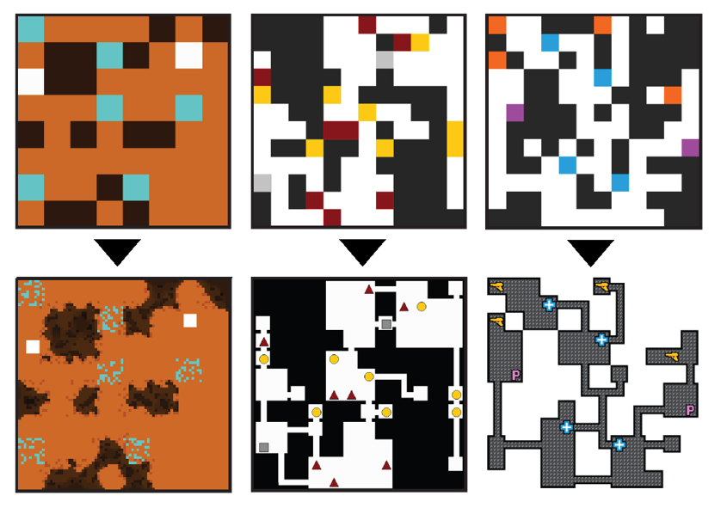
Map Sketches & Evolution of Segments
Under construction.
Map Sketches
Map Sketch Evolution
Dungeon Segments
Dungeon Segment Evolution

Slide 13
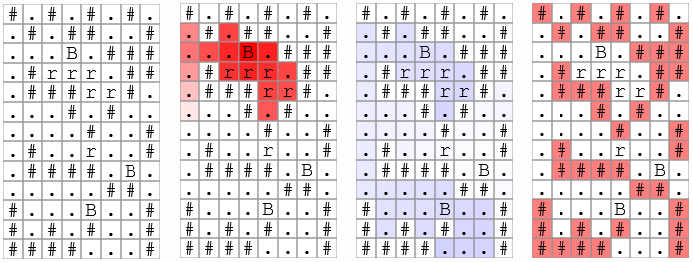

Map Sketches

Slide 14
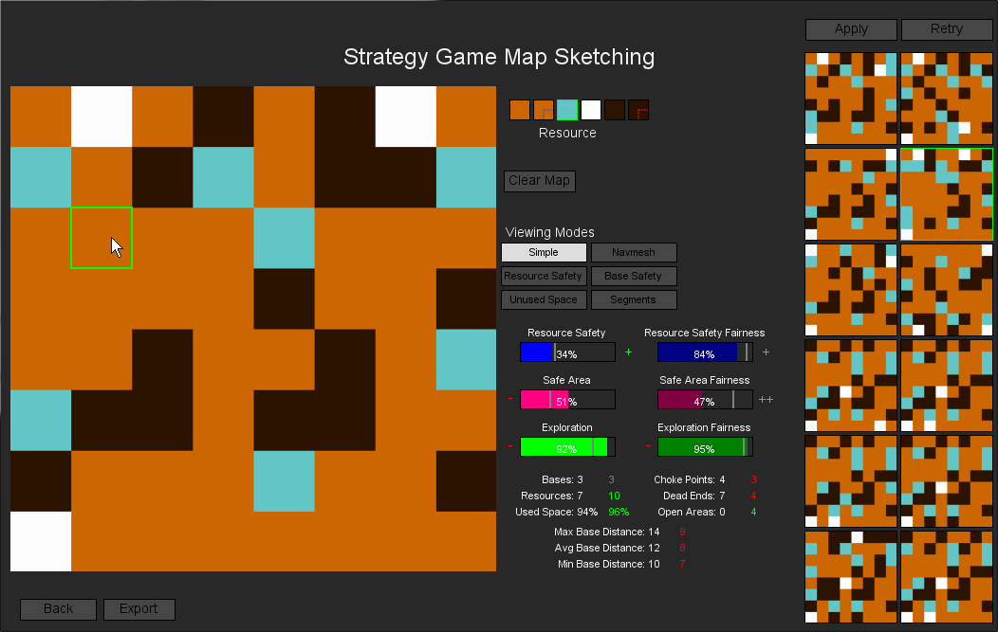
Map Sketch Evolution

Slide 15
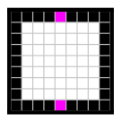
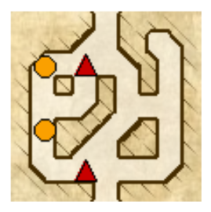
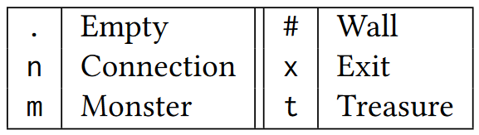
Dungeon Segments

Slide 16
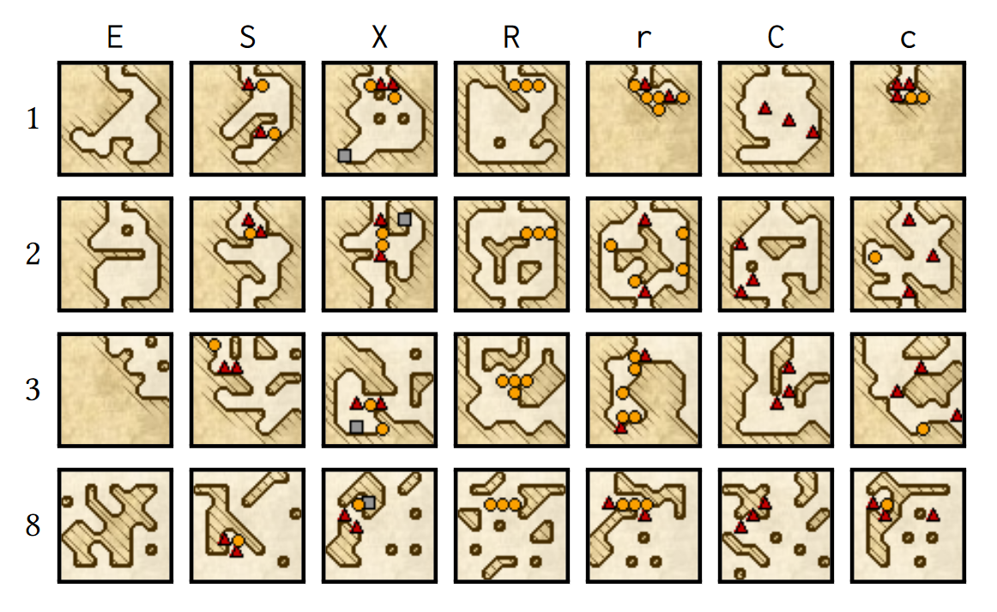
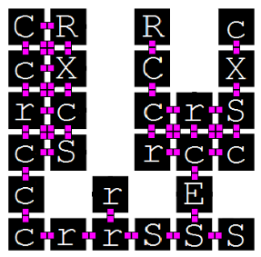
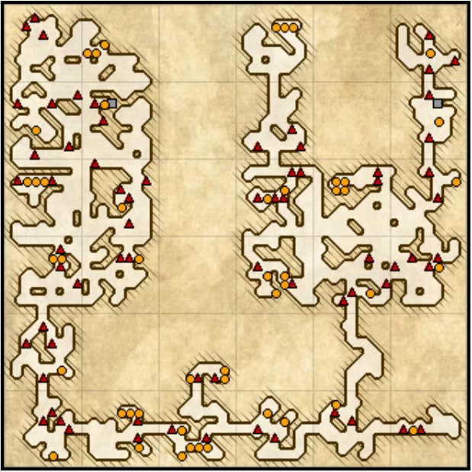
Dungeon Segment Evolution

Slide 17
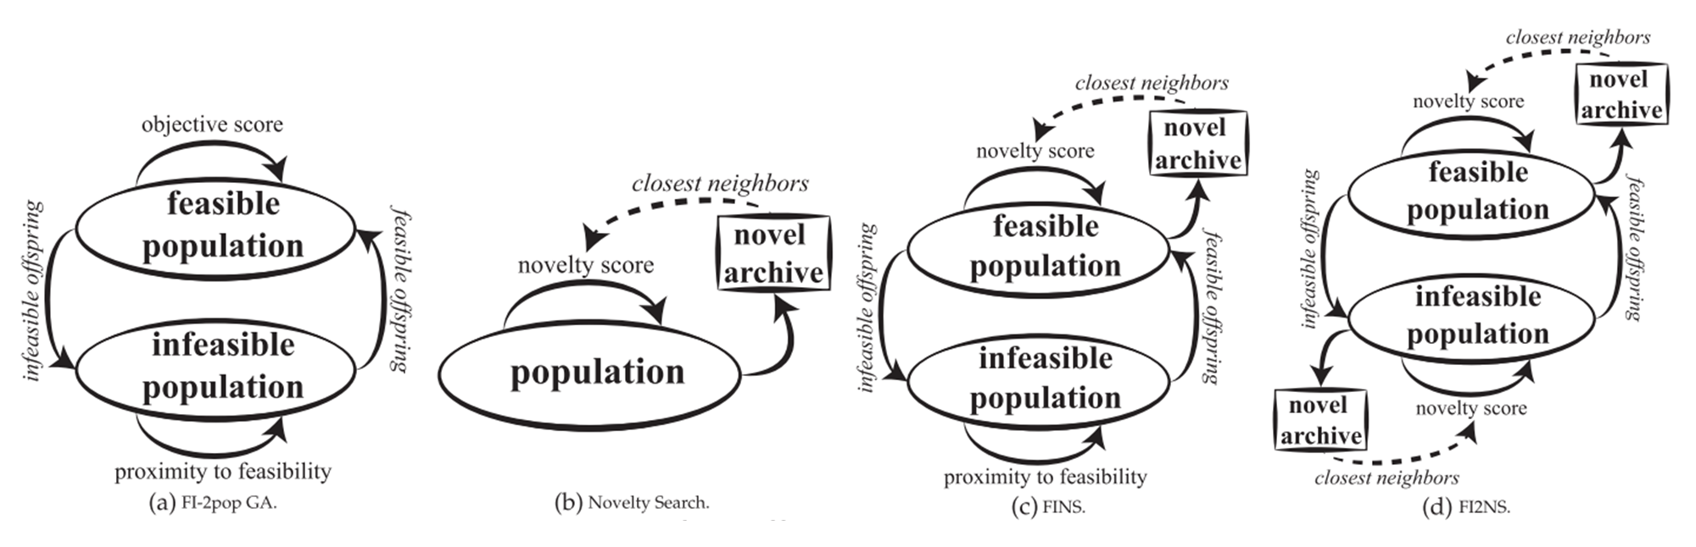
Constrained Novelty Search

Slide 18
Proposed Methodologies

Slide 19

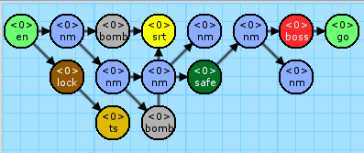


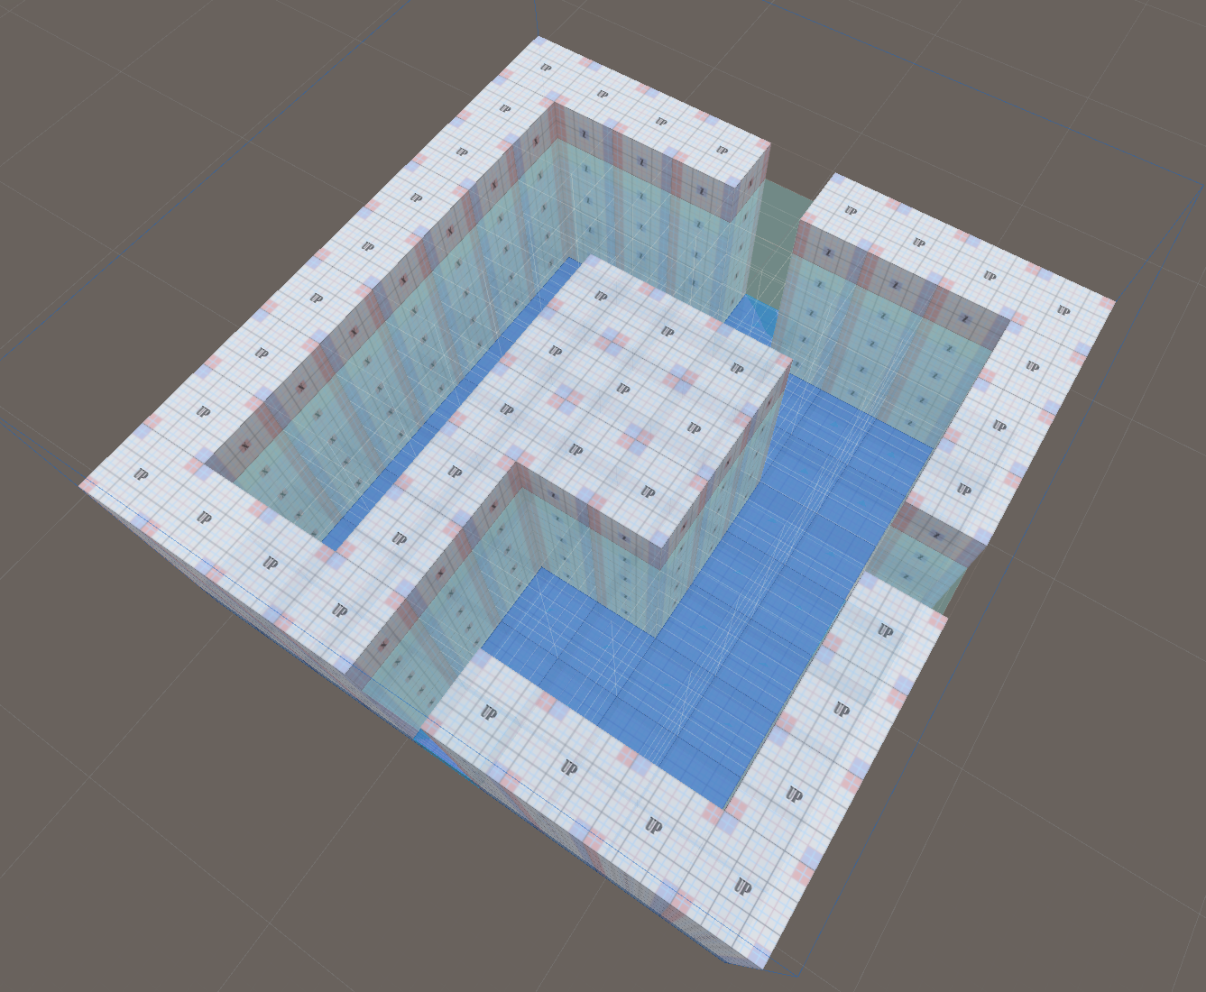
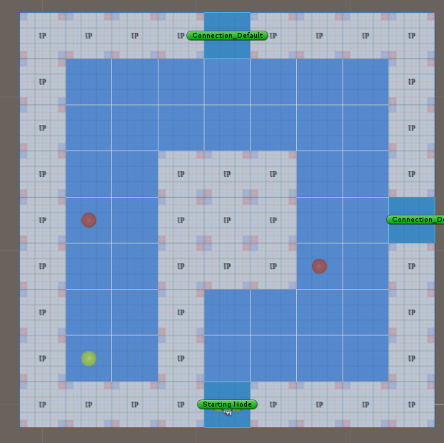
System Framework
- Phase 1 - Mission / Space framework
- Phase 2 - Dungeon Segment Evolution

Slide 20
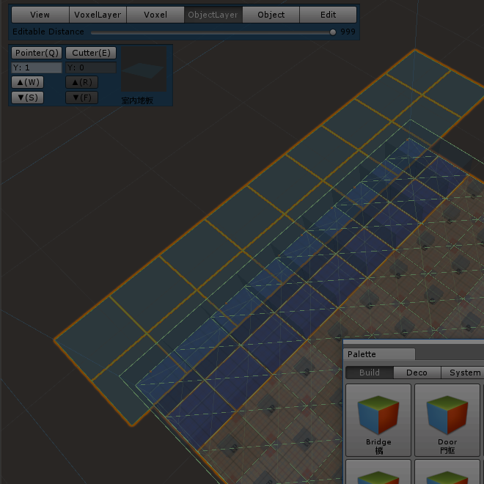
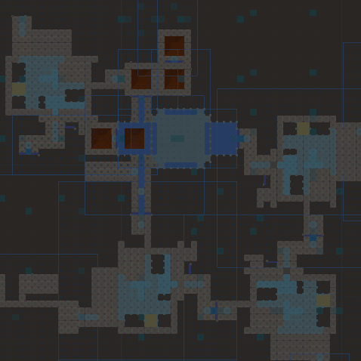
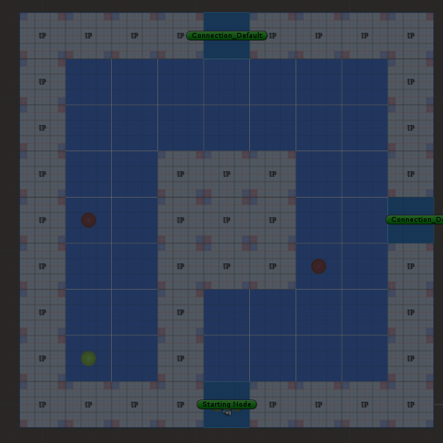
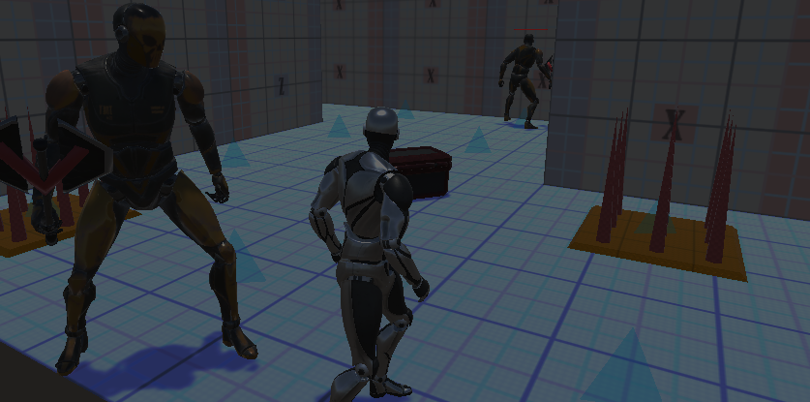
System Framework
1. Create Mission Grammars
Mission Alphabet
Mission Rules
Mission Graph
Rewrite System I
Random seed
Example of Mission Graph

Slide 21
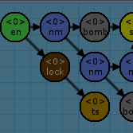

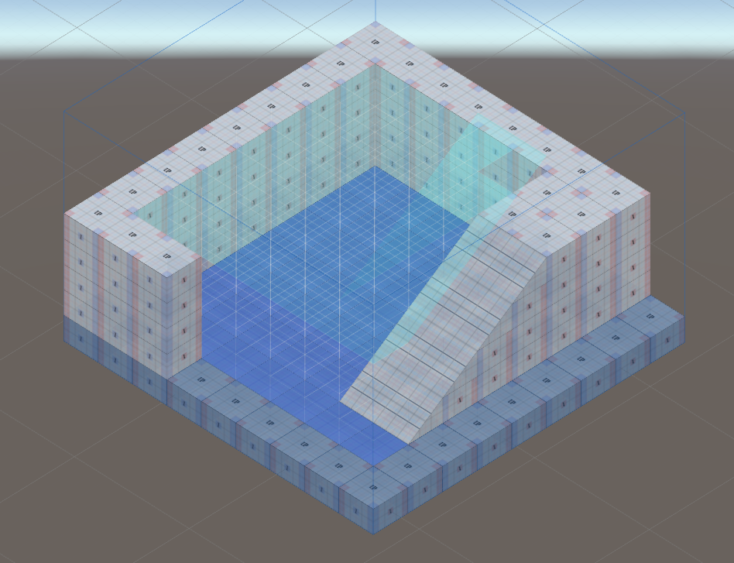
System Framework
2. Create Volumes
Voxel-based units
Decorations
Connections
Entrance
Exit
Example of volume

Slide 22
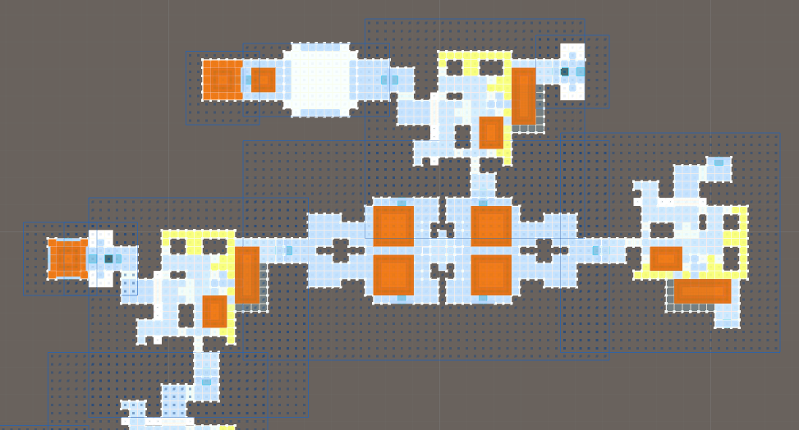
System Framework
3. Generate the Space
Rewrite System II
Instruction
Replacement
Collision issue
Example of space

Slide 23


System Framework
4. Generate the Gameplay Patterns
Genetic Algorithm for emergence objects
Nine main metrics to design the fitness functions

Slide 24
System Framework

Slide 25
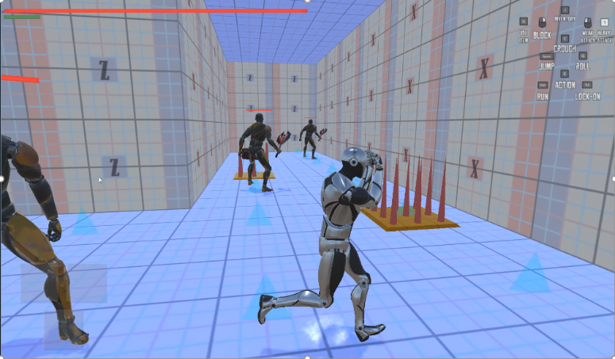
System DEMO
影片將會放置於此

Slide 26
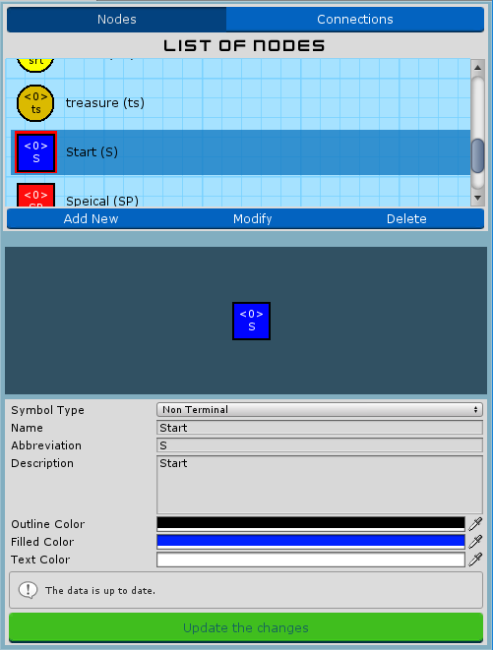
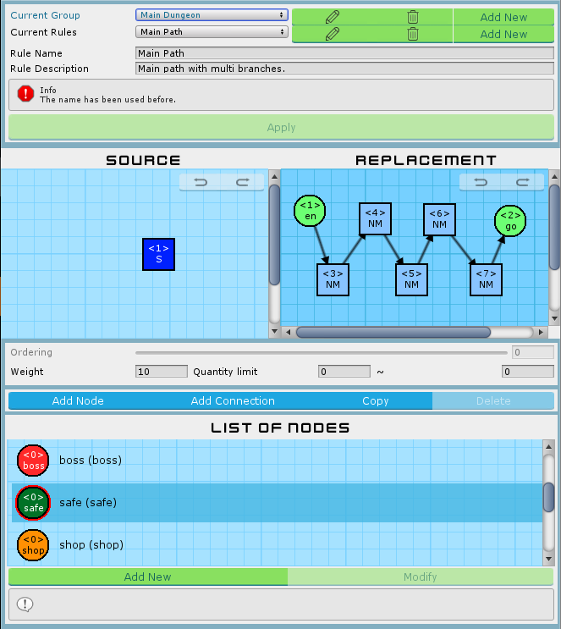
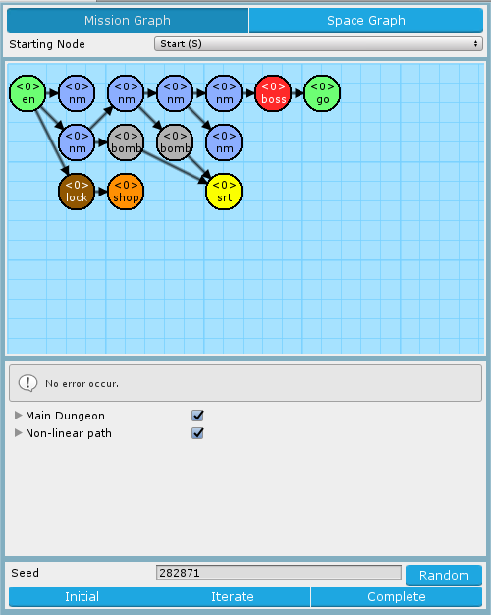


Mission Grammars
Mission Alphabet
Mission Rules
Mission Graph

Slide 27
Introduction of Mission Alphabet
List of symbols
Nodes and connections
Directly preview before selected
Preview area
Preview the symbol after editing immediately
Submit hint and form validations
Default and extended nodes
Default: None, Entrance, Goal
Extended: Any
Mission Alphabet Window

Slide 28
Introduction of Mission Rules
Hierarchy structure
Groups > Rules > Graph Grammar of Left-hand side & Right-hand side Rules
Friendly interface to create, delete and edit.
Rule canvas
Drag & drop to modify symbols
Custom size of canvas
Selected symbol highlighting
Connections stick on nodes automatically
Back trace the states (Redo / Undo)
Mission Rules Window

Slide 29
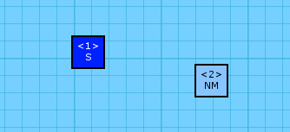
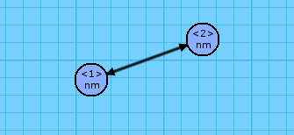
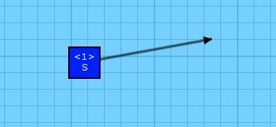
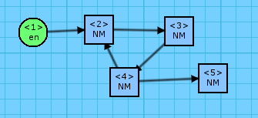
Avoid the illegal mission rules
Illegal rules will lead to the rewrite system generating fail or encounter the loop.
Isolated Node
Multiple Relations
Isolated Connection
Cyclic Link

Slide 30
Set of illegal mission rules
Illegal pattern | Description
Left More Than Right | 當左側的節點超過右側的節點數量時，進行改寫系統會使左側無法對應到右側的節點產生遺失的情形。若這些節點原先已有與其它非規則內節點連接，將會導致該連接資訊遺失，有機會造成任務圖破碎。
Empty Left | 左側為空將無法進行子圖搜索，因此左側節點必須至少一個節點。
Isolated Node | 孤立的節點將會導致任務圖破碎。
Isolated Connection | 孤立的連接線無法正確表示其連接資訊，將無法正常進行改寫系統。
Exactly Duplicated | 若左右規則同構將導致改寫系統陷入無限循環。
Multiple Relations | 兩兩節點間不可有超過一個的連接關係，不論是同向連接線或反向連接線皆會導致改寫系統無法正常運作。
Cyclic Link | 任務圖的定義中，任務應嚴格遵守任務間之順序性，若有循環結構將會使玩家迂迴停滯。
Orphan Node | 若有圖形語法含有兩個以上的根結點，便無法正確定位出任務起點。
Overflowed Any Node | 當右側規則使用 Any 節點時，其對應到左側索引值的節點亦必須為 Any 節點。反之，左側規則使用 Any 節點將不在此限。

Slide 31
Introduction of Mission Graph
Set starting node
The head of the mission graph
Preview mission graph
Rewrite system I
Based on the selected rules in mission grammars
Find the matched subgraphs using rules
VF Graph Isomorphism Algorithm ^{[1]}
^{[1]} VF Graph Isomorphism Algorithm: | https://www.codeproject.com/Articles/23144/A-C-Implementation-of-the-VF-Graph-Isomorphism-Alg
Mission Graph Window

Slide 32
Rewrite System I

Slide 33
Pseudocode of Rewrite System I
1 2 3 4 5 6 7 8 9 10 11 | Algorithm RewriteSystem1 (Node root) if matchedRule is found from root: // If not found then skip matchedRule = FindMatchs(TransToVFGraph(root)) // Transfer root into VF Graph Remove the connections of matched parts with matchedRule Replace the nodes based on right-hand side Append the nodes that additional index in right-hand side Re-add the connections based on right-hand side Remove the index information of nodes in graph for child := root->children: // DFS RewriteSystem1(child) return root

Slide 34
FindMatchs with the Random seed
1 2 3 4 5 6 7 8 | Function FindMatchs (VFGraph vfGraph) for rule := rules.shuffle(seed) // Random shuffle via random seed from random table if rule.QuantityLimitMax == 0: // If not found then skip continue if rule.leftHand is isomorphic to vfGraph: // Means the subgraph of vfGraph rule.QuantityLimitMax -= rule.QuantityLimitMax > 0 ? 1 : 0; return rule return root
Random table
Original “0” value has transferred to “-1” means the rule is unlimited usage

Slide 35
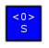
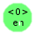
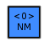
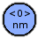

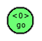



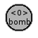

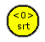

Manual
A
Create the Mission Alphabet
Node | Start | entrance | Normal | normal | boss | goal | safe | Special | shop | bomb | lock | secret | treasure
 | (S) | (en) | (NM) | (nm) | (boss) | (go) | (safe) | (SP) | (shop) | (bomb) | (lock) | (srt) | (ts)
Display
Quantity limit | 0 | 0 | 0 | 8 | 1 | 0 | 0 | 0 | 1 | 0 | 0 | 1 | 1
Require-ment |  |  |  |  | Battle and end |  |  | Multi -choice | Get the key from secret, then enter the secret or treasure room behind the wall that need to use the bomb to destroy it
※ Limit of Zero Means infinite.

Slide 36








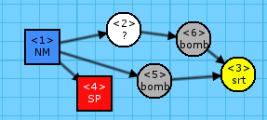
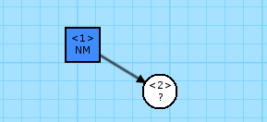
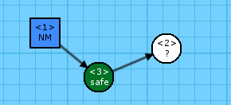

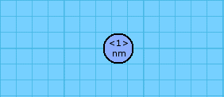





Manual
B
Design the Mission Rules
 | Source | Replacement
Main Path |  |  | Weight: | 10
 |  |  | Limit: | [0, ∞]
Boss Room |  |  | Weight: | 150
 |  |  | Limit: | [0, ∞]
Set Secret |  |  | Weight: | 30
 |  |  | Limit: | [1, 1]
Expora-tion |  |  | Weight: | 10
 |  |  | Limit: | [0, ∞]
More Branch |  |  | Weight: | 20
 |  |  | Limit: | [0, ∞]
 | Source | Replacement
Shop |  |  | Weight: | 10
 |  |  | Limit: | [0, 1]
Treasure |  |  | Weight: | 10
 |  |  | Limit: | [0, 1]
Extend Safe |  |  | Weight: | 10
 |  |  | Limit: | [0, 1]
Forward Lock |  |  | Weight: | 10
 |  |  | Limit: | [0, ∞]
Flat Rooms |  |  | Weight: | 10
 |  |  | Limit: | [0, ∞]

Slide 37
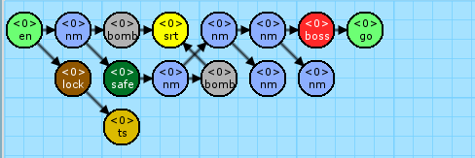
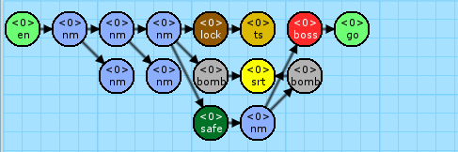
Manual
C
Export the Mission Graph
Set the starting node
Start to execute the iteration from the root.
Set the random seed (Random number table)
Seed affects selection when there are many candidates, or and the additional iterations ^{[1]} in the moment.
^{[1]} additional iterations: | The completed generation means all nodes in the graph are replaced to terminal nodes. Additionally executes more iterations to parallel rewrite the current graph.

Slide 38
Room Definitions and Instruction
Editor
Voxel-based units
Markers I - Decorations
Markers II - Connections
Rewrite System II
Instruction
Replacement
Pseudocode

Slide 39
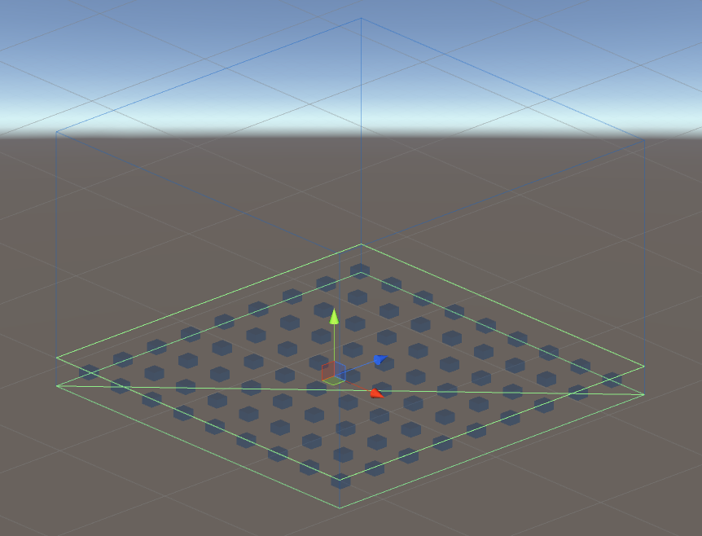
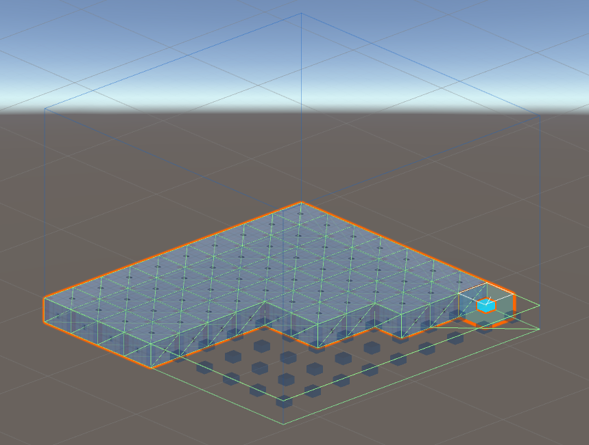
Voxel-based units in Editor
Hierarchy data structure
Level A set of volumes. Expresses a complete game level.
Volume A set of chunks. Mostly expresses a room.
Chunk Consists of 9x9x9 voxel. Based on the size of volume, uses different numbers of chunk.
Voxel The minimum unit of level, size is 3x2x3. It’s property is a block or decoration with nine orientations.

Slide 40
Decorations in Editor

Slide 41



Connections in Editor
圖片 需更換
圖片 需更換
圖片 需更換
Entrance
Zero or one
Inner direction
Exit
Any amount
Outer direction
The exits of “volume A” will stick with the entrance of “volume B”, according to their direction of arrow. If doesn’t exist any entrance, will pick one exit randomly.

Slide 42


Rewrite System II
Another rewrite system of Mission/Space framework.
Generate the Space from Mission Grammars.
srt
go
boss
en
lock
shop

Slide 43
Instruction of Rewrite System II
Space rules (simplify, expressed in 2D)
Mission graph
Space graph
C
Rule | build entrance
Inst. | en (entrance)
Rep. | Entance
Rule | grow section 2
Inst. | x (explore)
Rep. | Connection
W
C
1:en
2:x
3:go
C
C
C
W
C
C
W
W
C
Rule | grow section 1
Inst. | x (explore)
Rep. | Connection
Rule | goal
Inst. | go (goal)
Rep. | Connection
W
C
W
C
Each rule in the shape grammar was associated with a terminal symbol in the mission grammar.
Look for rules that implement that symbol, selects one at random based on their relative weight.

Slide 44
Replacement of Rewrite System II
Space rules (simplify, expressed in 2D)
Space graph
C
Rule | build entrance
Inst. | en (entrance)
Rep. | Entance
Rule | grow section 2
Inst. | x (explore)
Rep. | Connection
W
C
C
C
W
C
W
C
Rule | grow section 1
Inst. | x (explore)
Rep. | Connection
Rule | goal
Inst. | go (goal)
Rep. | Connection
W
C
Rule | close connection
Inst. | (none)
Rep. | Connection
wa
W
Rule | protowall2
Inst. | (none)
Rep. | ProtoWall
After all nodes in mission graph having transferred into space, the remaining connections have to fit the completed space.
Rule | protowall1
Inst. | (none)
Rep. | ProtoWall
W
wa

Slide 45
Pseudocode of Rewrite System II
1 2 3 4 5 6 7 8 9 10 11 12 13 14 15 16 17 18 19 20

Slide 46
Collision issue

Slide 47

Manual
D
Design the Volumes

Slide 48

Manual
E
Append the Entrance & Exit

Slide 49

Manual
F
Defined the Instruction of Rewrite System
List of the terminal symbols from Mission Grammars.
Elements in list, they have own volume list.

Slide 50
Manual
G
Defined the Replacement of Rewrite System

Slide 51
Genetic Algorithm in Segments Evolution
Genetic Algorithm
Algorithm flow
Gene
Crossover
Mutation
Fitness functions of GA
Common parts
Metrics

Slide 52
Algorithm flow

Slide 53




Gene
~
Basement
Gene Type
 | Empty
 | Enemy
 | Treasure
 | Trap
Gene
Ground
Individual (chromosome)
population

Slide 54
Crossover
2 point
Parents
Offspring
80% crossover
Two point crossover

Slide 55
Mutation
Parents
Offspring
10% mutation
Change 5% ~ 20% positions each chromosome

Slide 56
Fitness functions of GA
Common parts
Main Path Calculation
Normalize the fitness scores
Metrics
Neglected
Block
Intercept
Patrol
Guard
Dominated
Support
Cover
Trap

Slide 57
Main Path Calculation
A-Star in three-dimensional
委託廣柏整理清單

Slide 58







Normalize the fitness scores
Parameters
An example. If $N$ = 10
$f_{1}\left(0\right)=0.$0000 ; $f_{2}\left(0\right)=0.0000$
$f_{1}\left(1\right)≅0.3162$ ; $f_{2}\left(1\right)=0.1000$
$f_{1}\left(2\right)≅0.$4472 ; $f_{2}\left(2\right)=0.2000$
$f_{1}\left(3\right)≅0.5477$ ; $f_{2}\left(3\right)=0.3000$
$$f_{1}\left(x\right)={\left(\frac{x}{N}\right)}^{\frac{1}{2}}$$
$x$ : | Un-normalized scored
$N$ : | Number of enemy
$f\left(x\right)$ : | Normalized scored
$$f_{2}\left(x\right)=\frac{x}{N}$$
+0.3162
+0.1000
+0.1310
+0.1000
$f_{1}\left(x\right)$ is we expected
$f_{2}\left(x\right)$ is the original one
+0.1005
$+ 0.1$000

Slide 59


1st metric: Neglected
Fitness function:
Description: [會再翻成英文] 由於房與房之間的牆壁阻隔，使得敵人能夠埋伏於入口附近之死角處，出奇不意地對玩家展開攻擊。為了體現出這種現象，我們將敵人 ($E_{i}$) 與主要動線上各點 (${MP}_{i}$)，兩端點連線之對角線所構成的立方體，立方體所涵蓋各座標點 ($N_{j}$) 至該對角線的距離為 $d_{k}$，隨著距離增加影響程度會衰減；${vis}_{k}$ 為該點的可視情形，若有不可視的座標存在便會提高適應值。隨著動線的順序演進，影響程度逐漸衰減。
 | Enemy
 | Treasure
 | Trap
示意圖片 需更換
示意圖片 需更換
Example gameplay of “Neglected”

Slide 60


2nd metric: Block
Fitness function:
Description: [會再翻成英文] 敵人會專注於阻擋玩家繼續前進，迫使玩家與其發生衝突。$MP$ 為加總所有空間動線權重 ${mp}_{i}$；$E$ 為加總所有敵人於空間之動線權重 ($e_{j}$)，倘敵人並未落在動線上，權重則為0。為了達到隨著動線上的敵人愈多，對此適應性函數的影響力愈低，則取以 $MP$ 為底 $E$ 的對數。
 | Enemy
 | Treasure
 | Trap
$$f_{blk}=\log_{MP}{E},MP=\sum_{i=1}^{N}{{mp}_{i}},E=\sum_{j=1}^{M}{e_{j}}$$
示意圖片 需更換
示意圖片 需更換
Example gameplay of “Block”

Slide 61

3rd metric: Intercept
Fitness function:
Description: [會再翻成英文] 與阻攔點近似，但敵人會被配置於動線附近非動線上，以快速追擊玩家為目的。各敵人 ($E_{i}$) 越接近空間動線各點 (${MP}_{j}$) 時影響愈大，且動線權重 (${mp}_{j}$) 亦會影響加權程度。
 | Enemy
 | Treasure
 | Trap
示意圖片 需更換
示意圖片 需更換
Example gameplay of “Intercept”

Slide 62

4th metric: Patrol
Fitness function:
Description: [會再翻成英文] 為確保各敵人擁有足夠的空間能夠進行移動。利用 ${Cover}_{i}$ 計算敵人 ($E_{i}$) 在指定半徑 ($r$) 內，能夠行動的座標點數量比例，$count(E_{i}, r)$ 代表指定半徑內敵人可以行動的座標點數量； $plane(E_{i}, r)$ 代表以敵人為中心的指定半徑內，平面上所有座標數量（包含不可通行的牆壁等類型）。將 $count(E_{i}, r)$ 和 $plane(E_{i}, r)$ 的比例作為可以行動的座標數量比例。另外，本次實驗為三維空間，因此有機會出現可行走的數量大於平面上所有座標數量，在此對兩者比較大小，取最大值作為所有座標數量，以確保 ${Cover}_{i}$ 的數值介於0至1之間。
 | Enemy
 | Treasure
 | Trap
示意圖片 需更換
示意圖片 需更換
Example gameplay of “Patrol”

Slide 63



5th metric: Guard
Fitness function:
Description: [會再翻成英文] 為體現出敵人會保衛寶箱 ($T$)與出口 ($E$) 的現象，計算敵人 ($E_{i}$) 與關鍵性較高遊戲物件 ($O_{j}$) 之間的距離，倘若距離愈近則帶來的影響力愈大。
 | Enemy
 | Treasure
 | Trap
$$f_{grd}=\frac{1}{\left\|O\right\|}×\sum_{i=1}^{\left\|O\right\|}{\frac{\frac{\left\|E\right\|}{\left\|O\right\|}−\left|count\left(O_{i}, r\right)−\frac{\left\|E\right\|}{\left\|O\right\|}\right|}{\frac{\left\|E\right\|}{\left\|O\right\|}}}, o_{j}∈O=\left\{Treasure, Exit\right\}$$
示意圖片 需更換
示意圖片 需更換
Example gameplay of “Guard”

Slide 64

6th metric: Dominated
Fitness function:
Description: [會再翻成英文] 當玩家可能所在動線上之位置 (${MP}_{j}$) 與敵人的位置 ($E_{i}$) 具有高低差時，敵人便適合採取遠程攻擊；為了提供玩家思考對付遠程敵人的緩衝時間，將敵人配置於動線末端附近是較好的選擇，$j$ 隨著動線的順序演進，影響程度逐漸增幅。
 | Enemy
 | Treasure
 | Trap
示意圖片 需更換
示意圖片 需更換
Example gameplay of “Dominated”

Slide 65

7th metric: Support
Fitness function:
Description: [會再翻成英文] 敵人 ($E_{i}$, $E_{j}$) 之間擁有一定程度的護援關係，當敵人彼此的距離愈低其影響程度越大，同時該敵人 ($E_{i}$) 必須遠離動線 (${MP}_{k}$)。
 | Enemy
 | Treasure
 | Trap
示意圖片 需更換
示意圖片 需更換
Example gameplay of “Support”

Slide 66
8th metric: Cover
Fitness function:
Description:
 | Enemy
 | Treasure
 | Trap
示意圖片 需更換
示意圖片 需更換
Example gameplay of “Cover”

Slide 67
9th metric: Trap
Fitness function:
Description:
 | Enemy
 | Treasure
 | Trap
示意圖片 需更換
示意圖片 需更換
Example gameplay of “Trap”

Slide 68

Manual
H
Set the weights of fitness functions
Setting about fitness function weights of each volume
Same volumes can be duplicated used on different positions

Slide 69
Manual
I
Export the completed level

Slide 70
Experimental Results

Slide 71
Experiment design

Slide 72
Data Collection
Run no. | Gen. no. | Chm. no. | label | score | position | type | volume
• • •
1 | 10 | 3 | Block | 0 | (12.0, 1.0, 0.0) | Enemy | Room A
1 | 10 | 3 | Intercept | 0 | (12.0, 1.0, 0.0) | Enemy | Room A
1 | 10 | 3 | Patrol | 0.35 | (12.0, 1.0, 0.0) | Enemy | Room A
1 | 10 | 3 | Guard | 0.85 | (12.0, 1.0, 0.0) | Enemy | Room A
• • •
Raw data:

Slide 73
Data Filtering of Fitness Comparison
Run no. | Gen. no. | Chm. no. | label | score | position | type | volume
• • •
1 | 10 | 3 | Block | 0.35 | (12.0, 1.0, 0.0) | Enemy | Room A
1 | 10 | 3 | Intercept | 0.85 | (12.0, 1.0, 0.0) | Enemy | Room A
1 | 10 | 3 | Block | 0 | (12.0, 2.0, 0.0) | Empty | Room A
1 | 10 | 3 | Intercept | 0 | (12.0, 2.0, 0.0) | Empty | Room A
• • •
Calculate the sum of the fitness score each chromosome.
1 2 | // Remove useless columns. data.drop(['position', 'type']) // Remove duplicated rows. data.drop_duplicates([''])

Slide 74

Fitness Comparison

Slide 75
Data Filtering of Density Analysis
Run no. | Gen. no. | Chm. no. | label | score | position | type | volume
• • •
1 | 10 | 3 | Block | 0 | (12.0, 1.0, 0.0) | Enemy | Room A
1 | 10 | 3 | Intercept | 0 | (12.0, 1.0, 0.0) | Enemy | Room A
1 | 10 | 3 | Patrol | 0.35 | (12.0, 1.0, 0.0) | Enemy | Room A
1 | 10 | 3 | Guard | 0.85 | (12.0, 1.0, 0.0) | Enemy | Room A
• • •
Useless and duplicated
Store the positions and their gene types each chromosome (individual).
1 2 | // Remove useless columns. data.drop(['label', 'score']) // Remove duplicated rows. data.drop_duplicates(['Run no.', 'Gen no.', 'chm no.', 'position'])

Slide 76





Density Analysis

Slide 77





Density Analysis

Slide 78
Conclusions and Contributions

Slide 79
Conclusions

Slide 80
Contributions
Provide a systematic framework to make game designers develop the game level rapidly.
Mission-driven topology.
Tool about procedural content generation for mission graph.
Multi-objective problem in GA

Slide 81

Future Work

Slide 82


Pacing-based Level Generation

Slide 83

References
Dormans, J. (2010, June). Adventures in level design: generating missions and spaces for action adventure games. In Proceedings of the 2010 workshop on procedural content generation in games (p. 1). ACM.
Dormans, J. (2011, June). Level design as model transformation: a strategy for automated content generation. In Proceedings of the 2nd International Workshop on Procedural Content Generation in Games (p. 2). ACM.
Dormans, J. (2012, May). Generating Emergent Physics for Action-Adventure Games. In PCG@ FDG (pp. 9-1).
Karavolos, D., Liapis, A., & Yannakakis, G. N. (2016, September). Evolving missions to create game spaces. In Computational Intelligence and Games (CIG), 2016 IEEE Conference on (pp. 1-8). IEEE.
Liapis, A. (2017). Multi-segment Evolution of Dungeon Game Levels.
Karavolos, D., Bouwer, A., & Bidarra, R. (2015). Mixed-Initiative Design of Game Levels: Integrating Mission and Space into Level Generation. In FDG.
Liapis, A., Yannakakis, G. N., & Togelius, J. (2015). Constrained novelty search: A study on game content generation. Evolutionary computation, 23(1), 101-129.
Liapis, A., Yannakakis, G. N., & Togelius, J. (2013, April). Generating map sketches for strategy games. In European Conference on the Applications of Evolutionary Computation (pp. 264-273). Springer Berlin Heidelberg.
Font, J. M., Izquierdo, R., Manrique, D., & Togelius, J. (2016, March). Constrained Level Generation Through Grammar-Based Evolutionary Algorithms. In European Conference on the Applications of Evolutionary Computation (pp. 558-573). Springer International Publishing
Lanzi, P. L., Loiacono, D., & Stucchi, R. (2014, August). Evolving maps for match balancing in first person shooters. In Computational Intelligence and Games (CIG), 2014 IEEE Conference on (pp. 1-8). IEEE.
Zook, A., & Riedl, M. O. (2014, July). Automatic Game Design via Mechanic Generation. In AAAI (pp. 530-537).
Dormans, J. (2012). Engineering emergence: applied theory for game design. Creative Commons.
Neil, K. (2015). Game Design Tools: Can They Improve Game Design Practice? (Doctoral dissertation, Conservatoire national des arts et metiers-CNAM).

